Slide 1
Connecting to Data in Tableau
CSC105 – Fall 2021
Prof. Earl
Notes:
Title Slide

Slide 2
Connect to Data
Notes:
Section Header

Slide 3
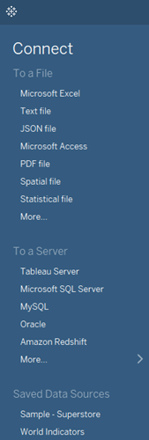
Connect to Data Screen
Tableau can connect to many file types
Excel
Delimited text files (*.txt, *.csv, *.tab, *.tsv)
PDF
Many more
Notes:
Point out in the Connect pane that we have a long list of native connections to all sorts of data sources. This is a real strength of Tableau. For this demonstration, we will focus on a very common data format – an Excel file.

Slide 4
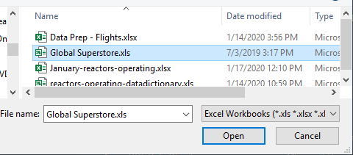
Connect to Global Superstore file
Click on Excel
Navigate to saved file
Click open
Notes:
For this example we’ll be using the “Global Superstore” Excel file, which you can download from the course website. Superstore is a data set of sales for a global retail chain that sells furniture, office supplies, and technology goods. We will use this particular data source extensively in this class.

Slide 5
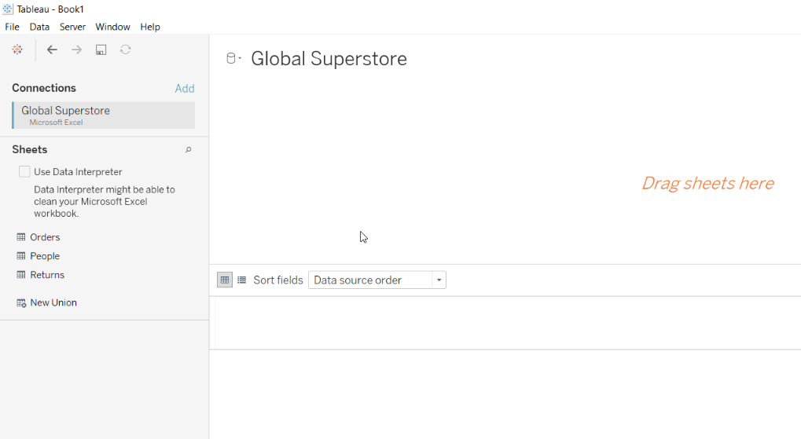
The Data Source Window
Drag Orders to “Drag sheets here” space
Notes:
Simply drag a sheet into the data connection canvas.

Slide 6
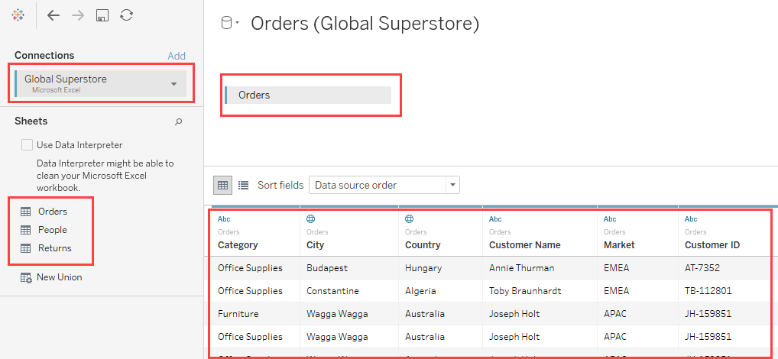
The Data Source Window
File Name (right-click to rename the connection, if desired)
Sheet that was dragged to the data connection canvas.
Preview pane shows row level data of the sheet in the canvas.
Sheets in the Excel File (treated as database tables; connect to a single table or join multiple tables)
Notes:
Now Tableau brings us to the Data Source window.
Here we can see the name of the file – and here we can right-click to rename the connection if desired
Down below, we can see all the sheets in the Excel file.
Sheets in Excel are treated the same as tables in databases, and we can choose to connect to a single table or join multiple tables.
Tables can be renamed simply by clicking on the name. The gear icon brings up options related to the data source.
We can see the data down in the preview pane.

Slide 7
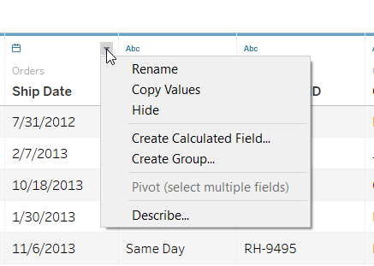
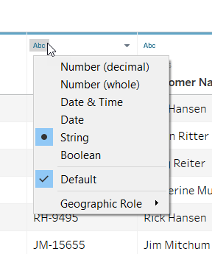
Editing Field Name and Data Type
Notes:
If the column names aren’t ideal, click on the drop down arrow to the right of the name and select "Rename".
Clicking on the data type icon changes the default data type for that column.
Note that we will cover data types in detail in Module Four

Slide 8
Live versus Extract
Notes:
Section Header

Slide 9
Live versus Extract
Before analyzing data consider connecting live or extracting data.
Connecting live leaves the data in the database or source file.
This is best when leveraging a high performance database’s capabilities, or to get up-to-the-second changes in data visualized in Tableau.
Sometimes connecting live can result in a slow experience, depending on the database.

Slide 10
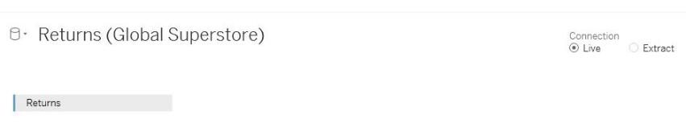
Live versus Extract
Alternatively, you can extract the data into Tableau's high performance in-memory data engine.
Helps when connecting to a slow database or to take query load off critical systems.
Can import only some of the data and bring in specific elements (to access those options, click Edit)
For now, we’ll connect live.

Slide 11
Quick Viz Example
Notes:
Section Header

Slide 12
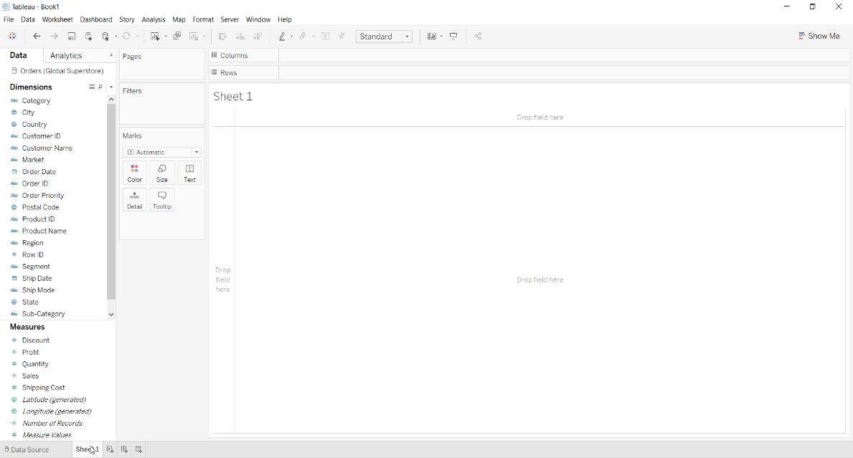
Worksheet canvas
Notes:
Click on Sheet 1 tab to open the canvas. If you ever want to go back to the data connection window, simply click on the Data Source tab.
Take time here to describe the data in more detail – this is worthwhile since we will be working with this data extensively in this course:
Discuss the most important fields in the data (category, sales, etc.)
Discuss that Dimensions are discrete and Measures are continuous (more on that later in the course)
Show how to click the magnifying glass to search your variables
Show right-click options for the variables (change a variable type, etc.)
Note that we will discuss this user interface in more detail later in the course

Slide 13
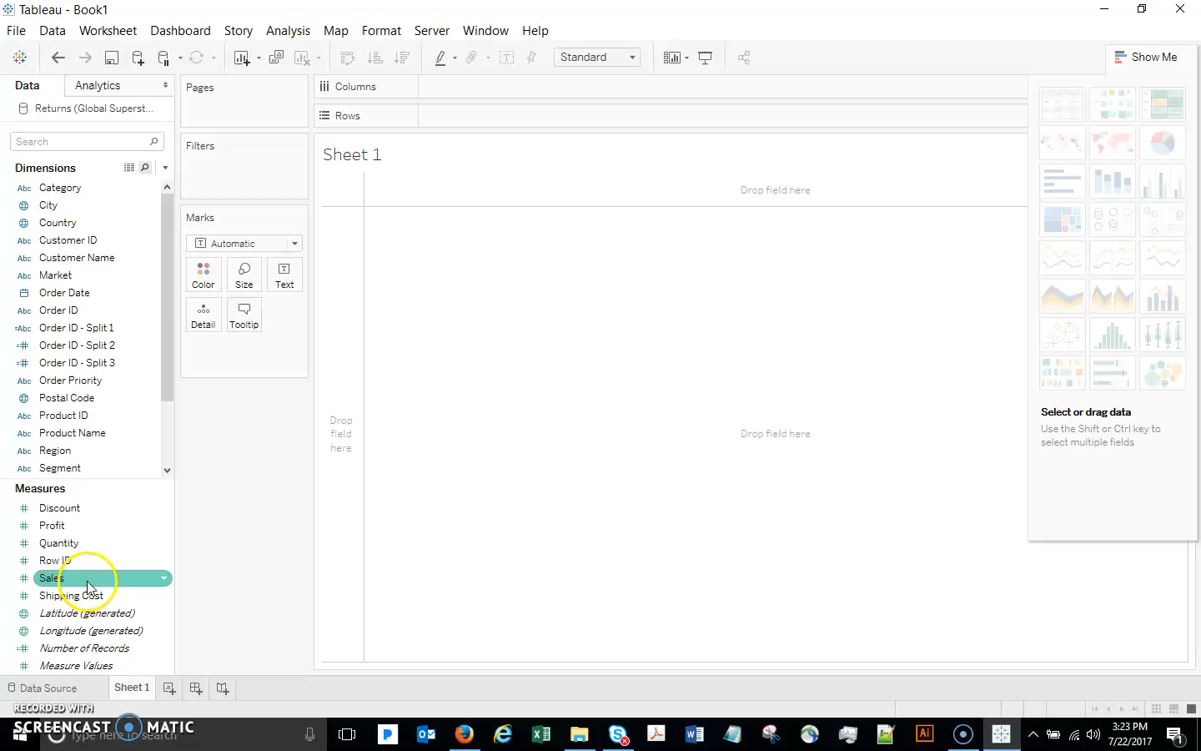
Quick Viz Example
Notes:
Do a quick viz example here
Use orders table(we will go through how to create a viz in much more detail later, but here is a quick preview with a couple important tips):
Double-click Sales (or Drag sales to rows) – this gives a single bar. Tableau has aggregated the data. What if you want to see more detail? If I want to see Sales at a more granular level, click Analysis, uncheck Aggregate Measures (If you want, you can reduce the size of the circles). Now we have more detail – this is an important feature! For example:
We now see how many marks there are
We can right-click a mark (or several marks), View Data, Underlying tab, and see the actual data (nice for investigating outliers, etc.)
Go back and check Aggregate Measures, and bring out Category (double-click). This gives a total (SUM), which is probably what we want, but we can easily change it to see the average sales price in each category (change to AVERAGE). Sort the bar chart. Use Marks card to adjust color and size, add/remove labels, etc.
Finally, drag out Sales, and drag Number of Records to the shelf. Discuss the importance of this field, which is automatically calculated for you. Quick was to see how many are in different categories!

Slide 14
Connecting to Multiple Tables
Notes:
Section Header

Slide 15
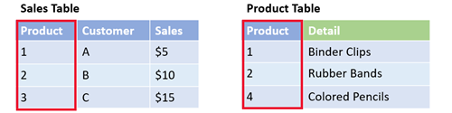
Joins
Joins relate two or more tables from one database into a single result set
Tables require a common field to define the relationship between the rows
Usually a key field or indexed field
In the tables below, Product is the common field:
Changing the join logic changes the results.

Slide 16
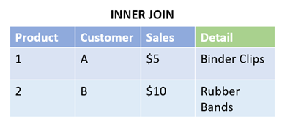
Inner Join
Returns only transactions that occur in both tables
Inner join is the default join in Tableau
In the example (Sales Table and Product Table), only matches for Product numbers that appear in both tables are returned
Not returned:
Unsold products (no corresponding row in Sales table)
Sales transactions with no matching records in Product table (for example, Product 3 to Customer C doesn’t exist in the Product table)

Slide 17
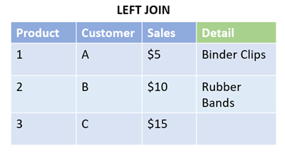
Left and Right Joins
Left join returns all rows from the left table and only matching rows from the right table
In the example, the left join relationship more accurately reflects the actual sales transactions that have occurred
The sale of Product 3 to Customer C is included in the result because the record was in the table on the left
Right join changes the direction of the join
In the example, a right join could help identify products that have not sold

Slide 18
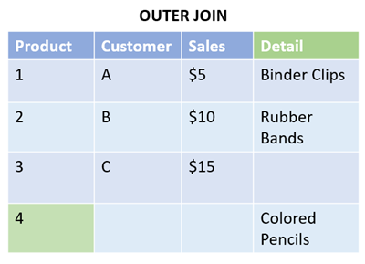
Full Outer Join
Full outer join returns all records from both tables
Leaves nulls where no matches exist
In the example, a full outer join could help discover where details are missing about a transaction, or where products are not being sold

Slide 19
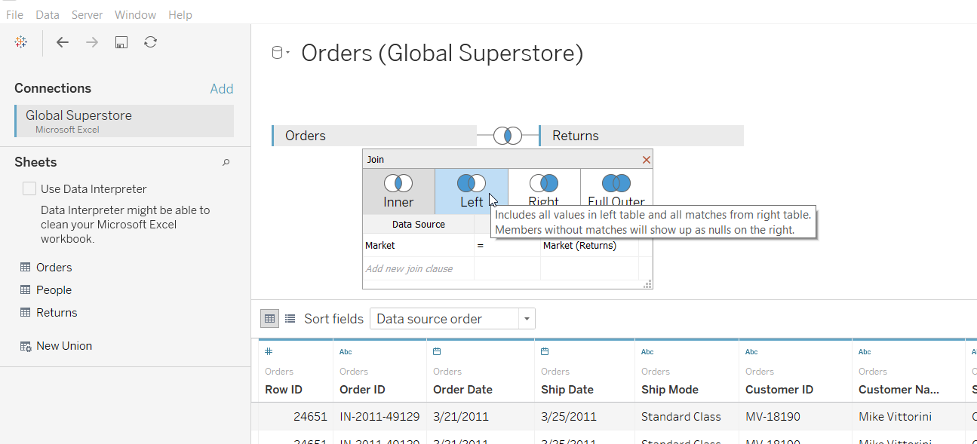
Connecting to Multiple Tables
Notes:
Let’s apply joins to our Superstore example:
To add columns from other tables in the same data source (i.e. other worksheets in our Excel file), we need to edit our data connection.
Click on the Data Source tab.
Join our Returns table to the Orders table.
Double click or drag out Returns.
Click on the join icon to show the details.
The default join clause is shown here.
Tableau has figured out that Market is a common field between these two tables.
If desired, we could edit the join clause, or even create a new one
For these data we could also select a left join (explain the difference).
For now we’ll change it to Left and close the dialog.
Again, we can view the data down here and verify the data we’ll be connecting to.
It looks good, so we’ll click back onto our sheet.
We now have columns from both Orders and Returns in our data window and are ready to start our analysis!

Slide 20
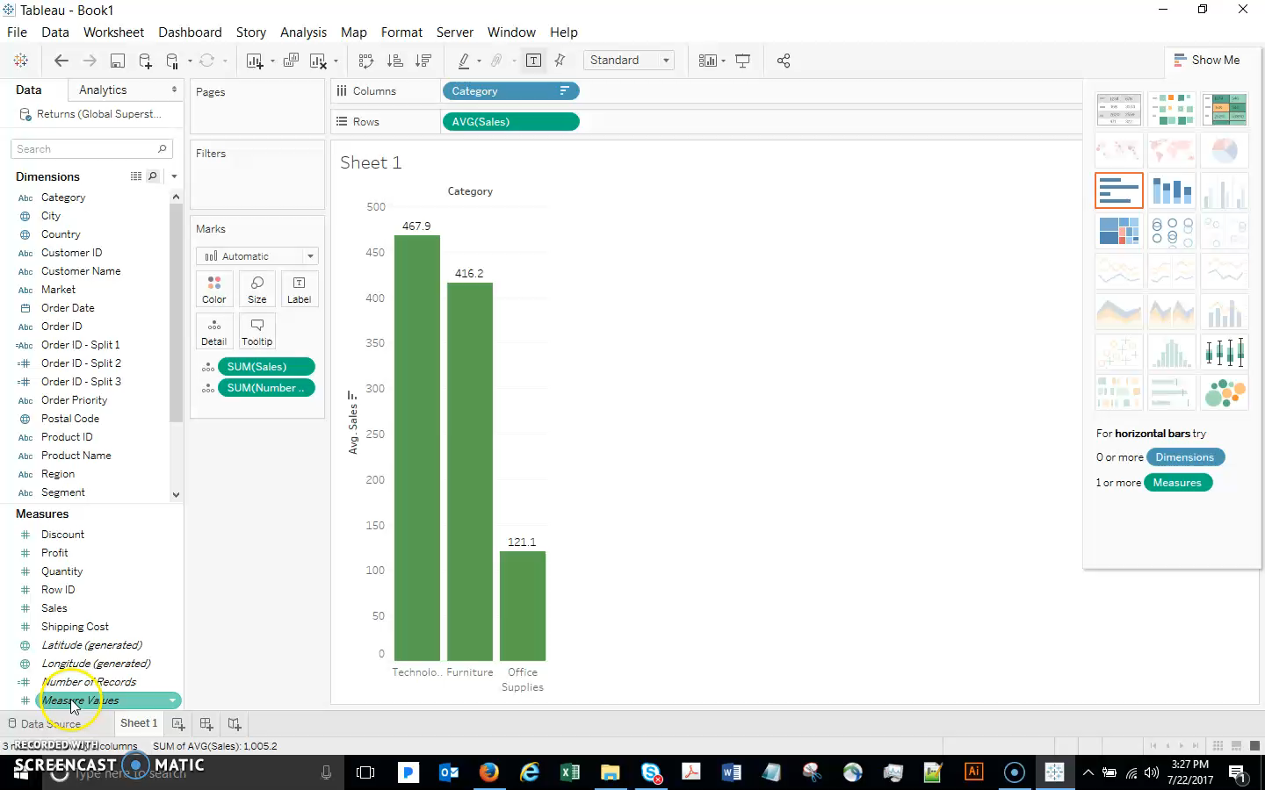
Connecting to Multiple Tables

Slide 21
Notes:
Tableau Logo

